Slide 1
Regional Value Chains & Productivity Enhancements: the Cases of Rice and Cacao in West Africa
William G. Moseley, Professor and Chair of Geography,
Director of African Studies
Macalester College,
1600 Grand Ave, Saint Paul, MN 55105 USA
Email: Moseley@macalester.edu
Notes:
Thanks to Christina for the kind introduction and to Lens CD for inviting me to share this paper. I also want to acknowledge the Africa Capacity Building Foundation which originally commissioned this paper for their 2014 Africa Capacity Indicators report.

Slide 2
I. Introduction
The goal of this presentation is to review the current state of value chains and production across African borders. More specifically, the presentation explores the role of regionalism in value chain development and examines ways to expand its most valuable aspects.
Notes:
Value chains, or the linkages from raw materials to finished products, have become a central focus of economic development activities in recent years. While the value chain approach is not a new idea, it is being emphasized anew in development scholarship and practice (Bair 2005). To date, initiatives to facilitate value chain development have occurred largely within the borders of nation states, although it is increasingly understood that some value chains may make more sense at the regional scale.
African states’ participation in regional value chains has been limited thus far. A lack of economic cooperation and production across African borders may be linked in part to historical and political factors that exacerbate cross-border tensions. Other factors limiting economic cooperation and integration—especially within Africa’s regional economic communities (RECs)—are more economic and cultural in nature, including poor infrastructure, linguistic barriers, weak regulatory environments, and poor border administration, each of which can increase transaction costs.
The goal of this presentation is to review the current state of value chains and production across African borders. More specifically, the presentation explores the role of regionalism in value chain development and examines ways to expand its most valuable aspects. The presentation also explores the kinds of policies and capacity building initiatives would be most effective for allowing Africa to better capitalize on cross-border value chain opportunities for economic development and improved livelihoods. The presentation highlights two case studies: the first examining a West African regional rice market; and the second exploring shared cacao processing and chocolate production between Ghana and Côte d’Ivoire.

Slide 3
Thesis
Building more robust value chains in Africa is critical for transforming raw materials into finished products, encouraging industrialization, and moving African economies beyond their peripheral position.
Notes:
I came to this research as a skeptic of the value chain approach because I was not convinced that further incorporating Africans into the global capitalist system was in their best interest. However, I have come to the conclusion that this is a useful approach because it can help African economies move out of their peripheral position as producers of raw materials only in the global economy.
As such, the overarching thesis of this paper is that building more robust value chains in Africa is critical for transforming raw materials into finished products, encouraging industrialization, and moving African economies beyond their peripheral position. Regional value chains may further develop this capacity by leveraging complementarities among different African countries and fostering knowledge creation and skill enhancement within the region.

Slide 4
II. Review of theoretical and applied literature on regional integration and value chains
A. The value chain framework and development in Africa
According to Hellin and Meijer (2006: 4), “A value chain can be defined as the full range of activities which are required to bring a product or service from conception, through the different phases of production (involving a combination of physical transformation and the input of various producer services), delivery to final customers, and final disposal after use.”
Notes:
According to Hellin and Meijer (2006: 4), “A value chain can be defined as the full range of activities which are required to bring a product or service from conception, through the different phases of production (involving a combination of physical transformation and the input of various producer services), delivery to final customers, and final disposal after use.”

Slide 5
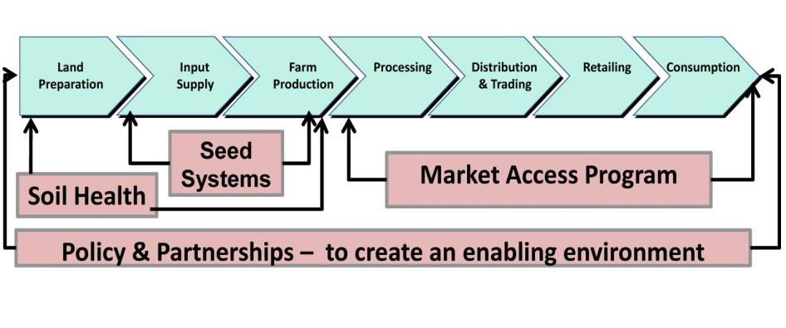
Alliance for a Green Revolution in Africa (AGRA)’s value chain approach for agricultural products
Notes:
Within the African aid context, the global value chain approach is a key element in, for example, agricultural development that then leads to even broader forms of industrial development (Toenniessen et al. 2008). Continuing with the agriculture example, the Alliance for a Green Revolution in Africa (AGRA) uses value chains to a certain end and sees these as the sequence of activities focused on the transformation of a crop from the farm to national levels. At the farm level, the value chain framework promotes the “upgrading” of agricultural production and food security by integrating farmers into new input and output markets in order to increase production, sales, and income. At the national level, the value chain approach seeks to transform the structure of national economies by promoting investments in agroprocessing to add value to products previously exported as unfinished goods. The Figure depicts these different steps for the AGRA project from inputs, to farming, processing, distribution, and trading.

Slide 6
B. Views on value chains
Value chain literature in economics and business vs. social science scholarship on commodity chains
Notes:
The value chain literature is dominated by economists and business management specialists but bears a strong resemblance to more interdisciplinary social science scholarship on commodity chains as well as other relevant economic geography literature on economic interdependence and agglomeration effects.
As Bair (2005: 153) has noted, there was “an important but generally unacknowledged break between the original world-systems inspired tradition of commodity chain research and two subsequent chain approaches, the global commodity chain and global value chain frameworks.” The economistic global value chain approach is increasingly focused on the meso and micro scales, and closer attention must be paid to “larger institutional and structural environments in which commodity chains are embedded” because of concerns about uneven development. In other words, the economistic global value chain literature views globalization as largely positive, framing those not integrated into the global economy as disadvantaged.
In contrast, the world systems theory inspired commodity chain approach sees these very same articulations as potentially problematic. The rub in much of this analysis is that African producers have limited agency in their engagement with these chains, whereas firms based in the Global North hold disproportionate sway. The question is how African producers and actors enhance their power vis á vis these chains.
One possible way for African producers to garner greater control within global value chains would be to encourage more upgrading of products on the continent. Furthermore, the value chain concept also has interesting connections to an older literature on import substitution. While this connection is somewhat missing in Anglophone scholarship, it is alive and well in the Francophone African policy literature pertaining to the “filière approach.” While traditional import substitution industries often struggled because of small markets in many African countries, the potential for regional scale import substitution was not seriously considered in the first decades following African independence.

Slide 7
C. Regional integration and value chains
Regional economic integration typically focuses on removing barriers to free trade and increasing the movement of people, labor, goods, and capital across national borders. It may also involve strategic investments in economic development initiatives that benefit multiple national stakeholders (Ndulu 2006).
Notes:
Regional economic integration typically focuses on removing barriers to free trade and increasing the movement of people, labor, goods, and capital across national borders. It may also involve strategic investments in economic development initiatives that benefit multiple national stakeholders (Ndulu 2006).
Regional economic integration and cooperation may facilitate some types of upgrading and value chain formation. While national planners likely prefer to pursue upgrading and value chain formation within their own borders, this may not be possible for many goods in a significant number of African countries.

Slide 8
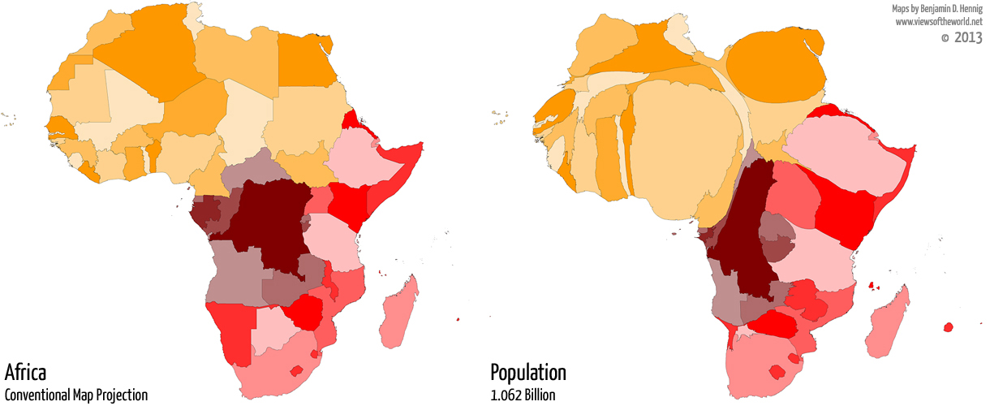
Small domestic market size for many African countries
Notes:
It is important to recall that of the 48 African countries (continental countries plus Madagascar), only 11 have populations of 25 million or more, and only 14 are estimated to have gross domestic products of US$ 50 billion or more. As such, roughly two-thirds of African nations are dealing with relatively small internal markets, making the traditional import substitution model (focused on upgrading of production for national markets) inherently limited. Because of constraints on demand within domestic markets, African upgrading is often focused on a handful of products with significant export potential.

Slide 9
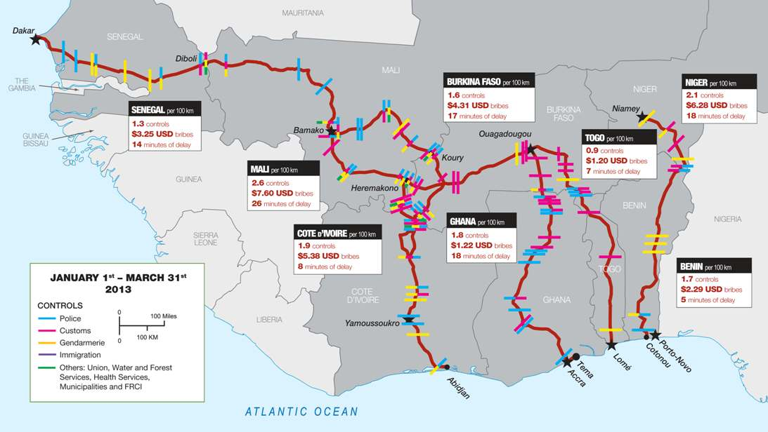
High Transit Costs
(Transit costs along selected West African road routes)
Notes:
Unfortunately, a complicating factor for export-oriented upgrading is the relatively high number of landlocked countries in Africa—a third, or 16 of 48 countries. In the absence of efficient border crossings, being landlocked typically makes it difficult to cheaply move heavier products to port for export.
Due to small market size and high transit costs for many African countries, regional economic integration may be especially useful for reducing the expense of transborder transactions, fostering vertical integration within regions, building agglomeration economies, increasing the size of internal markets, ensuring coordination, and sharing knowledge as well as R&D functions.
This figure depicts transit costs and times along selected major highway routes in West Africa. While some of these costs are accrued at roadside checkpoints within countries (which wouldn’t necessarily be allayed by regional integration), a high proportion do occur at and around international border crossings. Minimizing the time and cost of international border crossings is critical for building regional value chains.

Slide 10
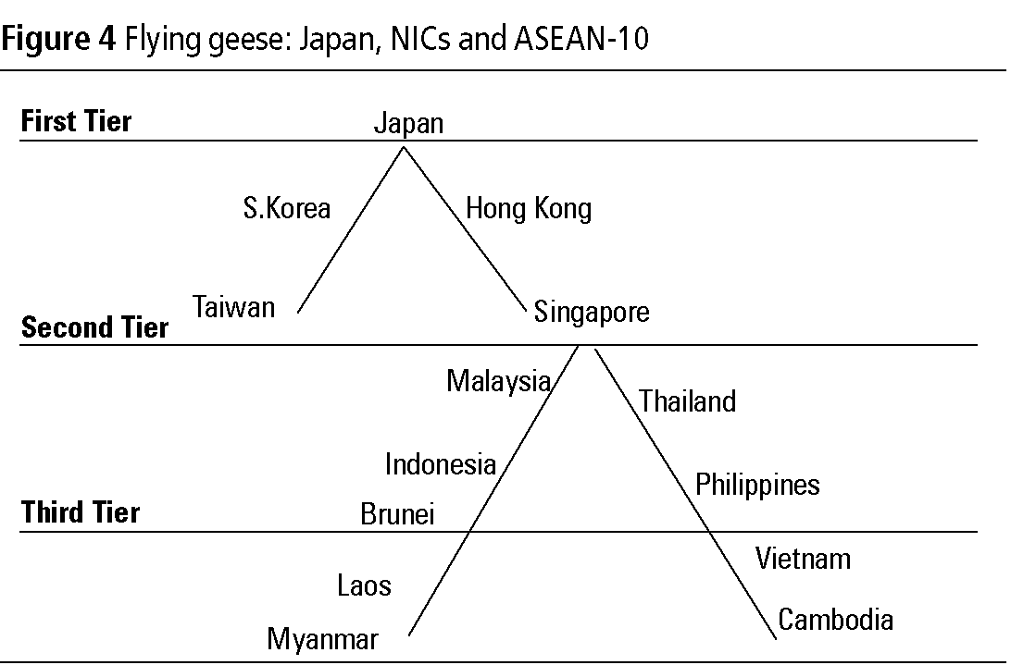
Agglomeration
Specialization & “Flying geese paradigm”
Notes:
Agglomeration: Regional integration may also foster agglomeration effects, which are the cost advantages that accrue to individual firms because of their location within a cluster. Examples of this might be proximity to suppliers and buyers, or shared use of transportation infrastructure.
Related to agglomeration effects is the notion of localization economies. Here you have clustering of firms in one particular industry (as opposed to the more generic clustering with agglomeration effects) because they mutually benefit from positive externalities. There may be a shared pool of labor with special skills, specialized technical schools, research institutes, and so forth. The clustering of financial services in Johannesburg might be an example of a localization or agglomeration economy. There is a localization economy associated with diamond cutting in Antwerp in the Netherlands, an industry that Botswana is now trying to bring, at least partially, to Gaborone.
A key question with regional integration, and with some degree of specialization between countries, is who will do what? In other words, how does one rationally integrate different national players into a single value chain? One potential model for thinking about economic integration, regional value chains, and complementarity is the “flying geese paradigm” developed by Japanese economist Kaname Akamatsu, who in 1962 argued for regional economic integration between different types of economies. Written from the perspective of Japan in the 1960s, Akamatsu’s thesis argued that Asian nations would catch up with the West by forming an Asian regional block within which the poorest countries produced the commodities that were subsequently transformed in the more advanced countries (or regional value chains). The metaphor was a flock of geese in V-formation, with Japan in the lead, then the second tier of NICs (South Korea, Taiwan, Singapore, and Hong Kong), followed by the lesser developed countries in the region. In other words, Akamatsu was essentially arguing for an acceptance of regional dualism as a way to break out of international dualism, or international core-periphery relationships.
One can certainly imagine such complementary economies in the African context. Countries with different factor endowments might include industrial South Africa and its neighbors, or food rich Mali and more agro-processor Côte d’Ivoire.

Slide 11
III. Exploring opportunities for regional value chains
A. Example of internally oriented regional value chain opportunity (rice in West Africa)
B. Example of externally oriented regional value chain 0pportunity (Cacoa in Ghana and Côte d’Ivoire)
Notes:
In the face of high border crossing charges and tariffs, African countries (unfortunately) often find it cheaper to import goods from non-African origins rather than their neighbors, and/or export raw materials to non-African destinations(rather than adjacent states) for transformation. This section explores a 2 examples where regional value chains could make a real difference for economic development: an internally oriented regional value chain opportunity (rice in West Africa); and externally oriented regional value chain opportunity (Cacoa in Ghana and Côte d’Ivoire).

Slide 12

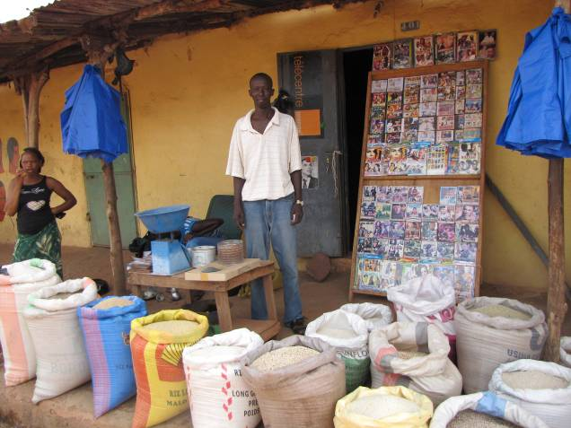
A. Example of internally oriented regional value chain opportunity (rice in West Africa)
Notes:
In recent decades, traders in coastal West African cities have often found it preferable to import rice rather than source it from their own hinterlands or neighboring states because of limited support for local producers, low international tariff barriers, poor milling quality, and expensive internal transport costs.

Slide 13
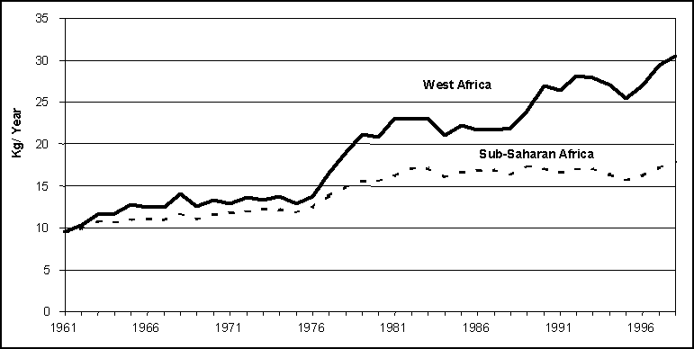
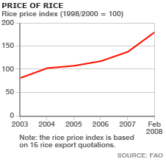
Notes:
The structural adjustment era decimated support (in terms of extension and research) for rice production across West Africa. Declining import tariffs, combined with cheap rice from abroad, further facilitated dependence on imports (Carney 2008; Moseley et al. 2010). The growing reliance on imports was also exacerbated by slightly different factors in specific countries. Côte d’Ivoire, for example, suffered from low milling quality after large industrial mills were shut down following neoliberal reforms (Becker and Yoboué 2009). In contrast, The Gambia was plagued by poor roads that separated producers up country from the milling facility and major markets in Banjul (Carney 2008).

Slide 14
Map of 2007-2008 Food Riots
Notes:
Over-dependence by urbanites on non-African rice supplies became a huge problem during the 2007–2008 global food crisis, when rice prices doubled (Seck 2008). The reality is that West African rice producers could supply these urban populations. The combination of a long history of rice production (African rice was originally domesticated in the region), shared research (such as ongoing work at the West Africa Rice Research Institute) and milling infrastructure, improved transportation networks, and more efficient border crossings could make the region more self-sufficient in rice production. While rice should not be emphasized at the expense of other food crops—especially orphan crops needed for diverse agro-ecosystems that are more resilient in the face of climate change (Mortimore and Adams 2001)—there is an argument to be made for replacing non-edible cash crops with food crops, such as rice, that may be traded regionally. With a robust market for rice in West Africa (driven largely by a burgeoning urban population that prefers rice (Moseley 2011)), the returns on this market may be better than on those for conventional cash crops. Such a shift might also add some stability to regional food markets and reduce the outflow of cash for food purchases.

Slide 15
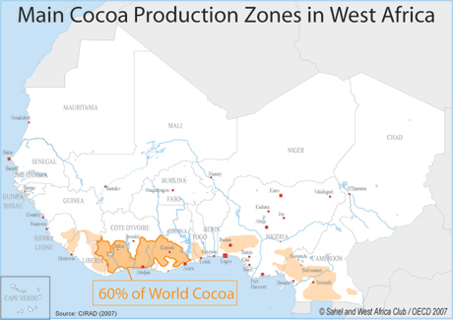
B. Example of externally oriented regional value chain 0pportunity (Cacoa in Ghana and Côte d’Ivoire)
Notes:
Another example (or a missed regional value chain opportunity) related to high border transaction costs, lack of coordination, and missing shared investment is Ghana and Côte d’Ivoire’s exportation of raw cacao rather than shared regional chocolate production (Ryan 2011). Côte d’Ivoire and Ghana are the top two cacao producers in the world and jointly account for 60-70 percent of global production. Yet West African cacao producers have been unable to leverage this dominance for a higher return on their crops. In fact, the typical cacao farmer sees approximately 4 percent of the price consumers pay for a chocolate bar in the store. As such, the disconnect between the consumers of this luxury item and the poverty of those who produce its main ingredient, cacao (from the pods of cacao trees) is rather startling. Given that this crop originally hails from Latin America , and has virtually no place in West African cuisine, it might be tempting to abandon it altogether as a cash crop. Yet, West African farmers remain competitive in this arena because cacao is actually cheaper to produce on small farms, as the plants require a lot of individual attention. Ryan (2011) concludes that fair trade efforts to garner a higher return for West African farmers have been largely been unsuccessful. Rather, government and regional cooperation could play a critical role in developing chocolate production.
A regional value chain built around these two cacao producing powerhouses could retain a significantly larger proportion of profits in the region and create new employment opportunities. The figure shows the major cacao growing areas in Côte d’Ivoire and Ghana. A shared chocolate production facility and related transportation arteries would most logically be located in the southern border area between the two countries. Differences in colonial language traditions (French and English) would clearly be an obstacle to be overcome.

Slide 16
IV. Key Approaches & Actors in African Regional Value Chain Development
Corridor approach (w/ figure of Idealized Development Corridor Configuration)
Notes:
This section explores the actors involved and their roles in regional value chain development, including the African Union (AU), regional economic communities (RECs), and private firms.
In early 2008, the Ministers responsible for Trade, Mining and Industry at the African Union (AU) began considering a new industrialization strategy based on development corridors, subsequently known as “A Plan of Action for Acceleration of Industrialization” (Jourdan 2008). The corridor approach was seen as a way to better link countries and create regional supply chains. The belief was that improved regional infrastructure and logistics would consolidate supply chains, enhance access to inputs at lower cost, and improve delivery of products to consumers. The corridor approach has been linked explicitly to Asian experiences inspired by the flying geese paradigm discussed earlier.
Cross-continental development corridors would pave the way for resource-based regional value chains by overcoming infrastructure constraints. Furthermore, it was argued that these corridors would allow for the reinvestment of profits into human resource development and R&D, with the outcome being “resource-industrial clusters” (Thomas 2009). The figure here depicts a hypothetical or idealized development corridor. In this transnational space, typically spanning two to three countries, one could imagine shared transportation infrastructure and R&D facilities. Such a space could also foster the agglomeration effects discussed earlier in this talk.

Slide 17
African development corridors and spatial development initiatives (SDI)
Notes:
There are currently 20 such corridors in Africa (see this figure). The United Nations Conference on Trade and Development (UNCTAD) is recommending that African countries and regional economic communities (RECs) transform traditional transport corridors into development corridors. Transforming traditional transport corridors into development corridors may make sense in many instances because it leverages existing investments.
That said, existing corridors may not always line up well with development opportunities. Case in point, these corridors may not match up with the best site for a shared cacao processing facility between Ghana and CI for joint production of chocolate or for transport of rice between major production areas, milling facilities and markets in West Africa.

Slide 18
Actors
Regional Economic Communities
Private Firms
Labor Unions
Notes:
1, Africa’s RECs are now becoming increasingly engaged with development corridors and regional value chains. The eight RECs recognized by the AU are moving toward implementing the Abuja Treaty on freer intra-African trade at different speeds.
2. Private sector firms are also central actors in regional value chains; players are as diverse as supermarkets, mining firms, agro-dealers, and agro-processors, and many are engaged in working across African national boundaries. One example of a private firm operating at the regional scale is AAR Health (based in Nairobi, Kenya). Modern health-care facilities are scarce in many areas of the region, and medical insurance is even more rare. This Nairobi-based private health-care company, which serves more than 140,000 members in East and Central Africa, operates in Kenya, Tanzania, Uganda, and Rwanda. The company started in 1984 as a medical evacuation specialist for expatriates but eventually expanded to provide general healthcare coverage to individual and corporate clients at a range of income levels. AAR Health now employs more than 1,000 people and has revenue of US$ 21 million a year. According to the company’s general manager, it hopes to expand further by focusing on patients who traditionally can't afford health care (Delevingne 2008). Given that insurance companies need large pools of clients in order to spread risk, it makes sense that such a company would operate regionally rather than nationally.
3. Another type of actor that is rarely discussed in the literature on value chains is the union, be it for laborers or farmers. Such organizations are important components of African civil society and can play key roles in mitigating some of the most egregious downsides of regional integration or development corridors. Unions often play critical roles in leveling the playing field across borders in terms of wages and producer prices. Strong producer unions can also advocate for African value chains on the international stage. A good example of this is when West African cotton farmer unions from Benin, Côte d’Ivoire, Niger, Mali, and Burkina Faso successfully joined forces with other cotton producers in Latin America and Asia to bring suit against the United States in the WTO over illegal cotton subsidies (Ledermann and Moseley 2008).

Slide 19
V. Conclusions and the way forward
Pool resources to engage in regionally relevant research and development (including some shared tertiary education resources)
Establishment of one-stop border posts
Transformation of agricultural products is often more economical at the regional scale
Notes:
Regional value chains hold the potential to drive sustainable growth in income and employment in sub-Saharan Africa. Key to unlocking this potential is implementation of the kinds of policies likely to be most effective in achieving this goal. To succeed, those policies should be supported by capacity building initiatives that will allow African nations to expand cross-border value chains (at various scales) for economic development and improved livelihoods.
1) It makes sense to pool resources to engage in regionally relevant research and development. Throughout much of Francophone West Africa in the post-colonial period, the Compagnie Française pour le Développement des Fibres Textiles (CFDT), or French Textile Development Company, established vertically integrated supply chains for cotton production and transformation. While much about this system could be criticized (including the limited proportion of profits returned to farmers), one of its great strengths was regionally specific R&D for seeds and cropping systems (Bassett 2001).
Regional level R&D also applies to some aspects of tertiary education. For example, Botswana, Lesotho, and Swaziland historically shared some university functions. While much of this collaboration has been abandoned, especially as Botswana has grown wealthier and developed its own facilities, the benefits of collaboration and specialization should not be lost. Not all African countries, for example, can afford to develop their own medical schools. In fact, even relatively wealthy Botswana has struggled to do this. Developing complementary university facilities (for example, an engineering school in one country and a medical school in another) with reciprocity agreements would make a lot of sense.
2) Establishment of one-stop border posts. One of the main tools used for trade facilitation is the one-stop border post (OSBP). The concept is used to minimize delays at cross-border points on major transport corridors in a region (often caused by poor facilities, manual processes, lengthy and non-integrated procedures, and poor traffic flow). Under the one stop border post (OSBP) concept, all traffic stops once in each direction of travel, facilitating faster movement of persons and goods and allowing border control officers from the two states involved to conduct joint inspections. The concept was first used at the Chirundu crossing between Zambia and Zimbabwe and was judged successful. It has now been widely adopted in various RECs, including COMESA, EAC, ECCAS, ECOWAS, and SADC (UNECA 2013).
3) Transformation of agricultural products is often more economical at the regional scale. Several African cities (among others, Nairobi, Johannesburg, Abidjan, and Lagos) have served as regional hubs for transformation of agricultural products. While such industries may be unsustainable at the national scale (particularly in smaller African countries), regional markets make such industries more viable. In this presentation, I have argued that cacao and rice processing at the regional scale in West Africa may make some sense.
There are hopeful examples of agroprocessing at the national and regional scale that may be used to inspire other similar efforts. For example, at the national scale, the dairy industry in Kenya is also growing fast, and there would seem to be huge opportunities to cater to a more regional market (Scholten and Basu 2013). In fact, the pace of change in developing processed milk and cheese products has been referred to as a “white revolution” wherein producers are coming together in regional cooperatives to collect, pasteurize, package, and distribute milk.
In another example, a banana value chain has been developed in Kampala, Uganda. With support from the European Centre for Development Policy Management (ECDPM), bananas are being sourced from smallholders and then processed to obtain fresh, vacuum-sealed, peeled banana packages. Improved technology and support services are also made available to small farmers. The value chain contributes to better, safer, and longer storage of the number one staple in Uganda. The value added packaging also increases revenue, and now the group has started sourcing additional bananas from Kenya. While the approach is still handicapped by difficulties moving bananas across borders, the progress made to date is impressive (Rampa 2013). More broadly, the project hints at future prospects for value chain development.
In sum, the overarching conclusion of this paper is that building more robust value chains in Africa is critical for transforming raw materials into finished products, encouraging industrialization, and moving African economies beyond their peripheral position. Regional value chains may further develop this capacity by leveraging complementarities between different African countries and fostering knowledge creation and skill enhancement within the region.

